Slide 1
Olympic Game Analysis:
Summer vs Winter (1980-2016)
Lynn Foster Jr
Kahan Shah
Patricia Taylor
Rahmeen Zindani

Slide 2
Olympic Game Analysis
Introduction
In this project, we will discuss the history of the Olympic games from 1980 to 2016, exploring the performances of countries across both Summer and Winter Olympics. Our analysis will focus on comparing these performances, breaking down specific sports by gender to uncover trends and insights over the years. Through this study, we aim to highlight the evolving dynamics of global competition.

Slide 3
CONTENTS
01
Physical Attributes
02
Age Distribution
03
Distribution of Athletes by Season
04
Popular Sports
05
Athlete Participation Over Time
06
Geographic Analysis
07
Countries Winning the Most Gold Medals

Slide 4
01
Physical Attributes
How do the average height and weight of athletes vary between the Summer and Winter Olympics, and what does this tell us about the physical demands of each season?

Slide 5
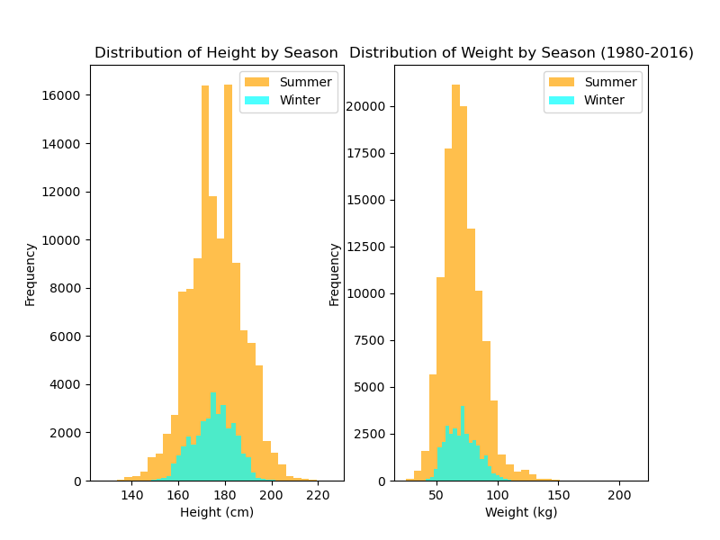
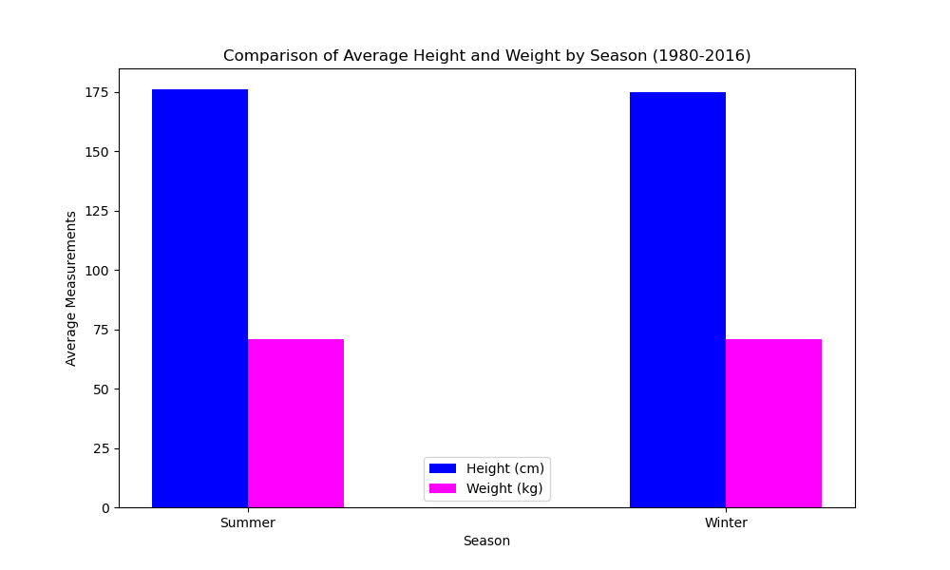
Physical Attributes

Slide 6
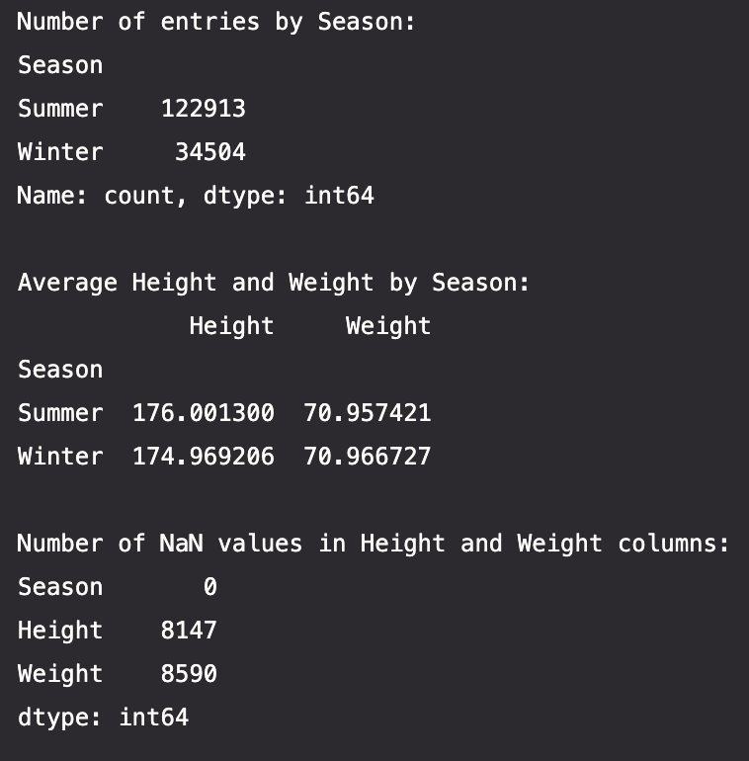
Physical Attributes
Average Height and Weight Comparison:
Athletes in both Summer and Winter Olympics have similar average heights, with a slight difference (Summer: 176.0 cm, Winter: 174.9 cm).
The average weight of athletes is also very close between the two seasons (Summer: 70.95 kg, Winter: 70.97 kg).
Distribution of Height:
The height distribution shows that a larger number of athletes in both seasons fall within the 160-180 cm range, with Summer athletes slightly taller on average.
Distribution of Weight:
The weight distribution indicates that most athletes, regardless of season, weigh between 50-80 kg. However, there is a slightly wider distribution in weight for Summer athletes, suggesting a more varied range of physical builds

Slide 7
02
Age Distribution
What are the age trends of athletes in the Summer and Winter Olympics, and how do these trends reflect the demands of different sports?

Slide 8
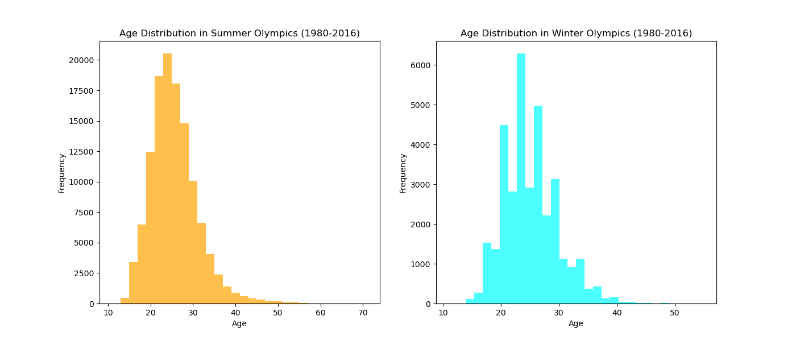
Age Distribution
Age Range:
The age distribution for both Summer and Winter Olympics predominantly falls within the 20-30 year age range.
Peak Age:
The peak age for athletes in the Summer Olympics is around 24-25 years, with the highest frequency of athletes in this age group.
In the Winter Olympics, the peak age appears to be slightly younger, around 22-23 years

Slide 9
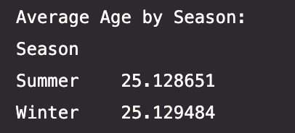
Age Distribution
Wider Age Distribution in Winter:
The Winter Olympics show a wider spread in age distribution, with more athletes participating across a broader range of ages, particularly between 15 and 35 years.
The Summer Olympics have a more concentrated age distribution, with fewer athletes over the age of 35 compared to the Winter Olympics.
Fewer Older Athletes:
Both Summer and Winter Olympics have relatively few athletes over the age of 40, indicating that most competitors are younger adults.
Average Age:
The average age of athletes in the Summer Olympics and Winter Olympics is approximately the same, 25.13 years.
This suggests that, on average, athletes in both the Summer and Winter Olympics are of similar age, around 25 years. Despite the slight differences in distribution shown in the previous chart, the central tendency in terms of age is nearly identical between the two seasons.

Slide 10
03
Distribution of Athletes by Season
How does gender distribution of athletes differ between the Summer and Winter Olympics?

Slide 11
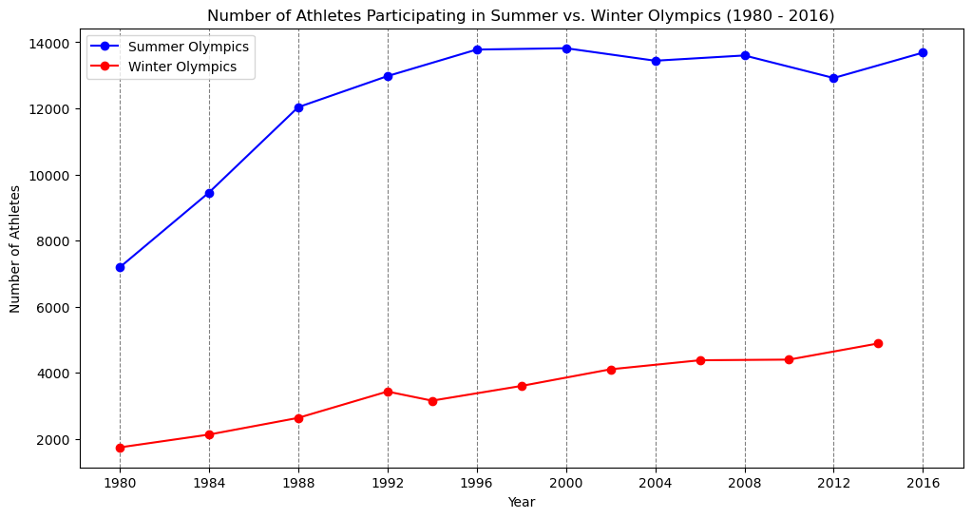
Distribution of Athletes by Season
How does gender distribution of athletes differ between the Summer and Winter Olympics?
Summary
In 1980:
There were 8,937 (7,191 summer & 1,746 winter) participants in the winter olympics.
In 2016:
There were 18,579 (13,688 summer & 4,891 winter) participants in the winter olympics.
Participants increased by 90% in the summer olympics and increased by 180% in the winter olympics.

Slide 12
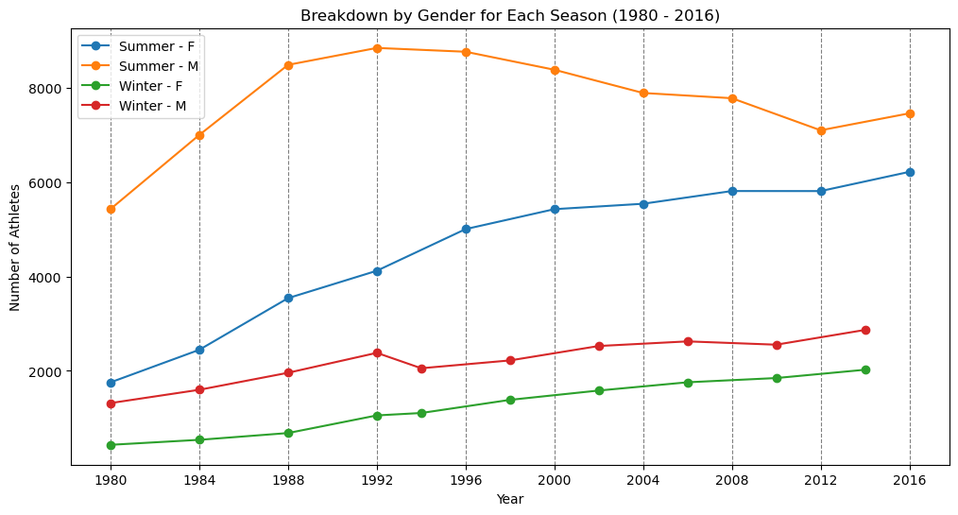
Distribution of Athletes by Season
How does gender distribution of athletes differ between the Summer and Winter Olympics?
Summary
Summer Olympics:
Male Participation: Increased by 37% (from 5,435 in 1980 to 7,465 in 2016).
Female Participation: Saw a significant rise of 254% (from 1,756 in 1980 to 6,223 in 2016).
Winter Olympics:
Male Participation: Increased by 118% (from 1,316 in 1980 to 2,868 in 2014).
Female Participation: Experienced the highest growth, with a 370% increase (from 430 in 1980 to 2,023 in 2014).

Slide 13
04
Popular Sports
Which sports are the most popular in the Summer and Winter Olympics, and how have participation trends in these sports evolved since 1980?

Slide 14
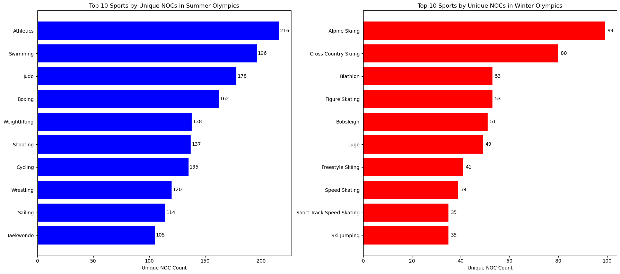
Popular Sports
Which sports are the most popular in the Summer and Winter Olympics, and how have participation trends in these sports evolved since 1980?
Summary
Summer Olympics:
Athletics: 216 countries
Swimming: 196 countries.
Judo: 178 countries.
Winter Olympics:
Alpine Skiing: 99 unique countries.
Cross Country Skiing: 80 countries.
Biathlon & Figure Skating: 53 countries each.

Slide 15
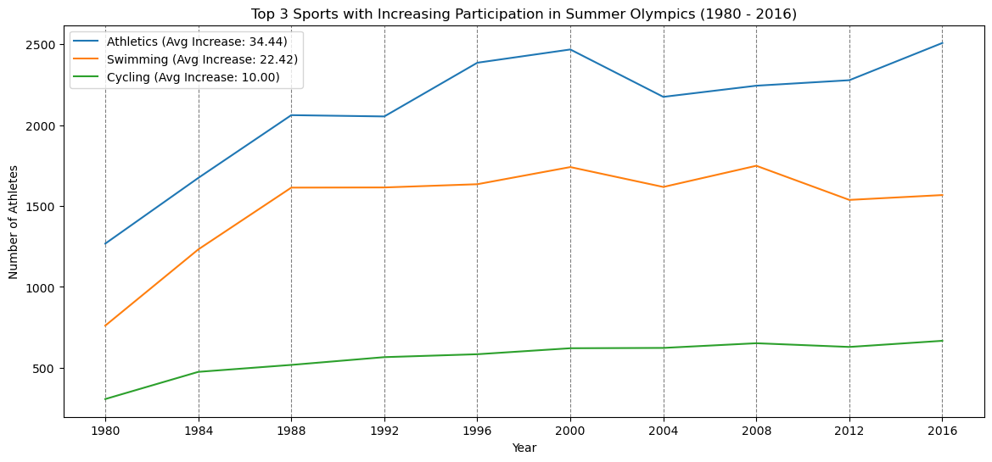
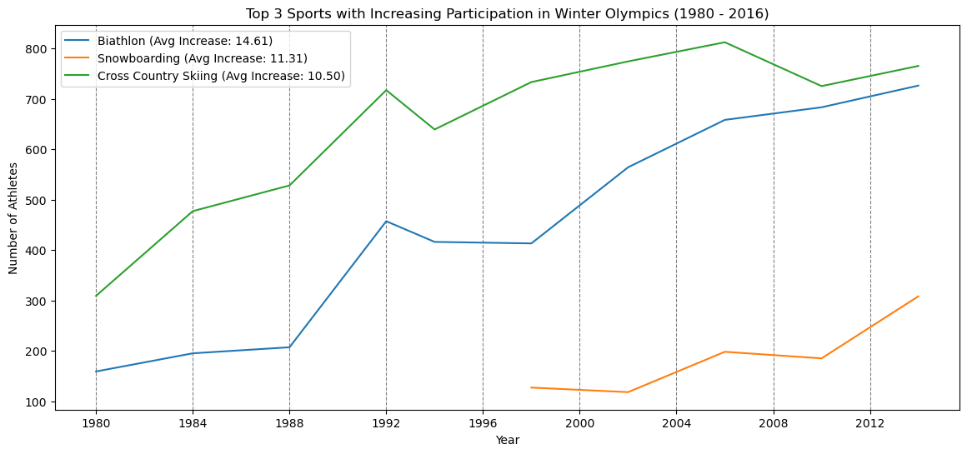
Popular Sports
Which sports are the most popular in the Summer and Winter Olympics, and how have participation trends in these sports evolved since 1980?
Summary
Summer Olympics:
Athletics: 34.44 athletes per year.
Swimming: 22.42 athletes per year.
Cycling: 10 athletes per year.
Winter Olympics:
Biathlon: 14.61 athletes per year.
Snowboarding: 11.31 athletes per year.
Cross Country Skiing: 10.50 more athletes each year.

Slide 16
05
Athlete Participation Over Time
How does the participation of new versus returning athletes differ between the Summer and Winter Olympics?

Slide 17
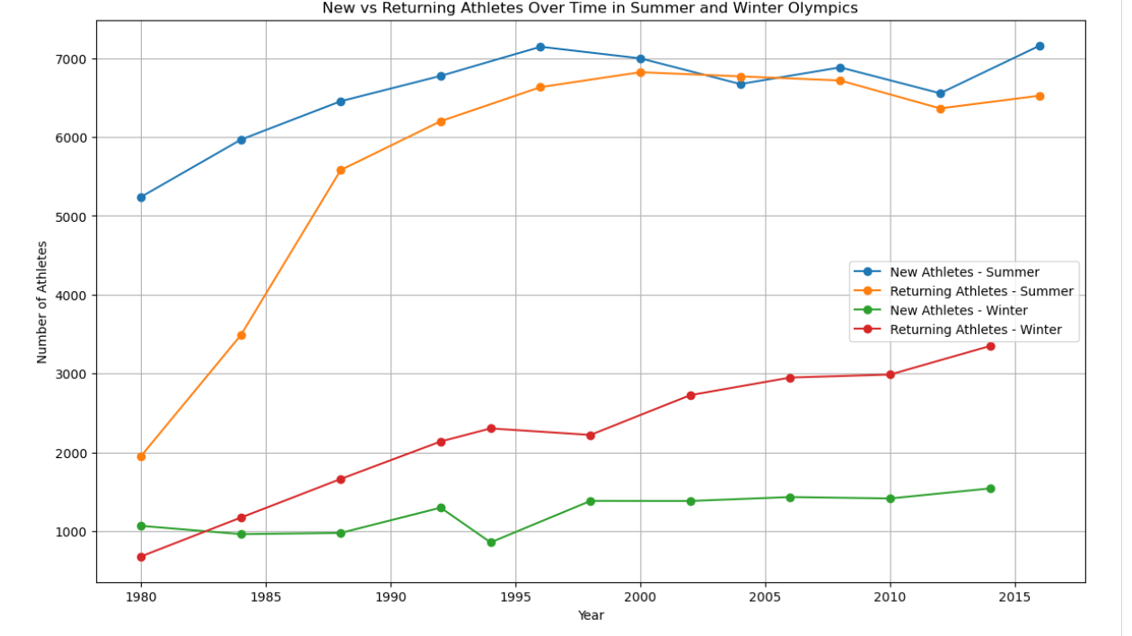
Athlete Participation Over Time
How does the participation of new versus returning athletes differ between the Summer and Winter Olympics?
Summary
We can clearly see through this plot map, that more athletes choose to participate in the summer olympics vs. the winter olympics.
Throughout the years we can also see that the returning athletes for the summer was continuing in a steady rate.

Slide 18
06
Geographic Analysis
Which countries have the highest participation in the Summer and Winter Olympics?

Slide 19
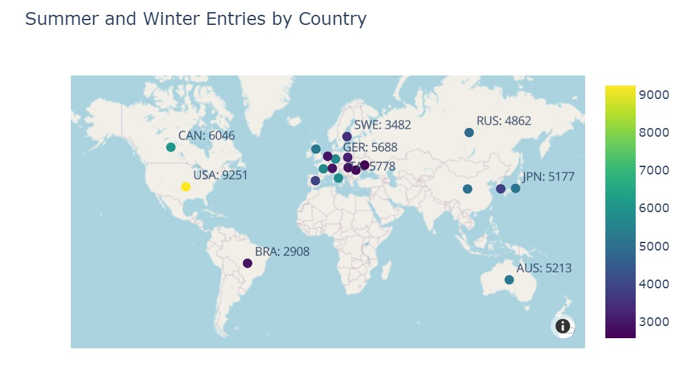
Geographic Analysis:
What countries have the highest participation in the Summer and Winter Olympics?
Olympic Participation Summary (1980-2016)
218 territories/countries across the world have athletes compete in both Summer and Winter Olympics.
Participation is higher in Summer Olympics vs WInter Olympics

Slide 20
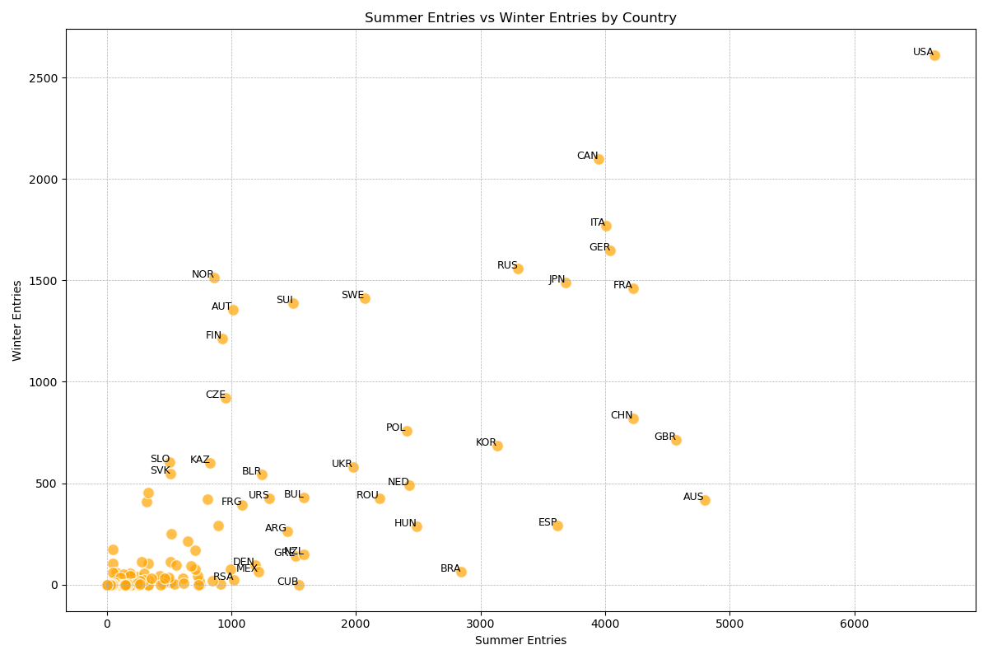
Geographic Analysis:
Olympic Participation (1980-2016)
USA:
6,642 (Summer)
2,609 (Winter)
9,251 Total Entries
Canada:
3,949 (Summer)
2,097 (Winter)
6,046 Total Entries
Italy:
4,007 (Summer)
1,771 (Winter)
5,778 Total Entries

Slide 21
07
Countries Winning the Most Gold Medals:
Which countries win the most in the Summer and Winter Olympics, and how does hosting the Games affect a country's performance?

Slide 22
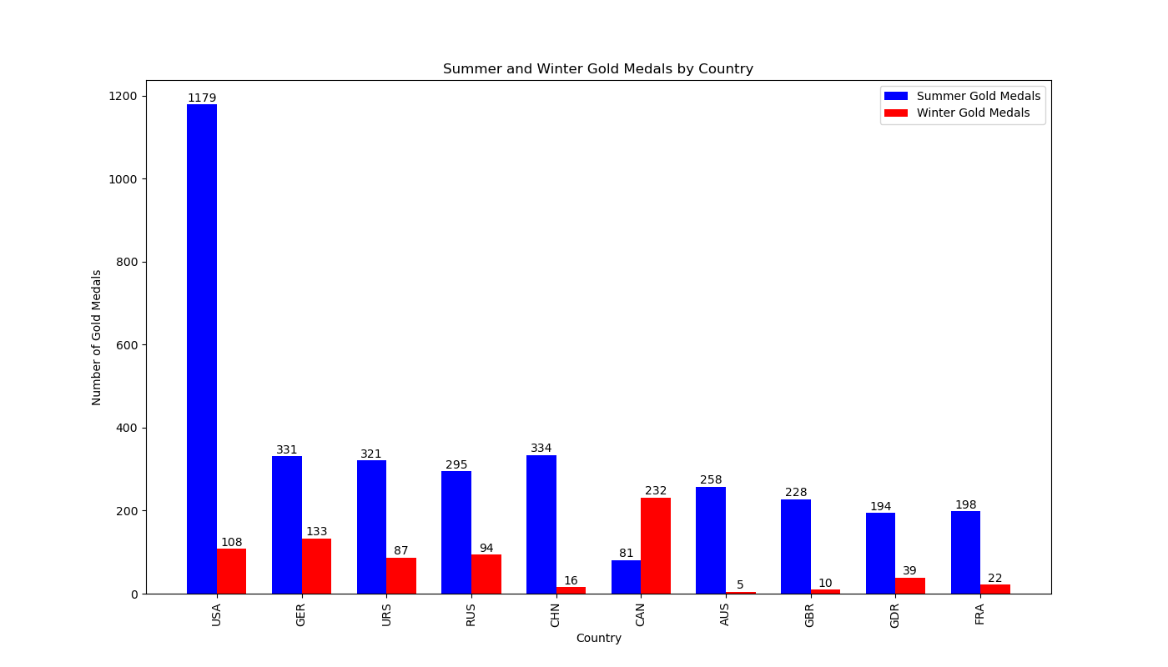
Countries Winning the Most Gold Medals:
Countries Winning the Most Gold Medals:
Do countries win more Medals in Summer or Winter Olympics?
Summary
While many countries typically achieve higher participation and win more gold medals in the Summer Olympics compared to the Winter Games, Canada stands out as an exception.
They perform notably better during the Winter Olympics than the Summer Olympics.

Slide 23
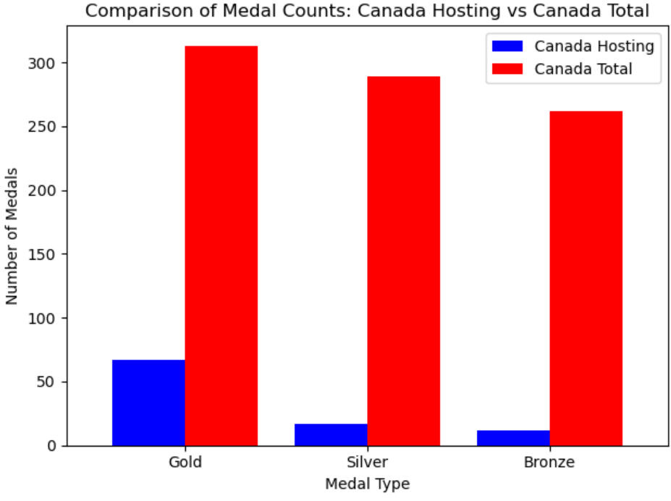
Hosting Performance vs Not Hosting Performance:
How does hosting the Games affect a countries performance?
Canada as the Host
Hosted Winter Olympics in 1988 (Calgary) and 2010 (Vancouver).
21.4% of Canada's gold medals were won in these two years.
11% of Canada's total medals (864) were won during these host years.
Overall Performance:
Hosting the Olympics can boost medal performance, as evidenced by Canada's significant medal count during their host years.

Slide 24
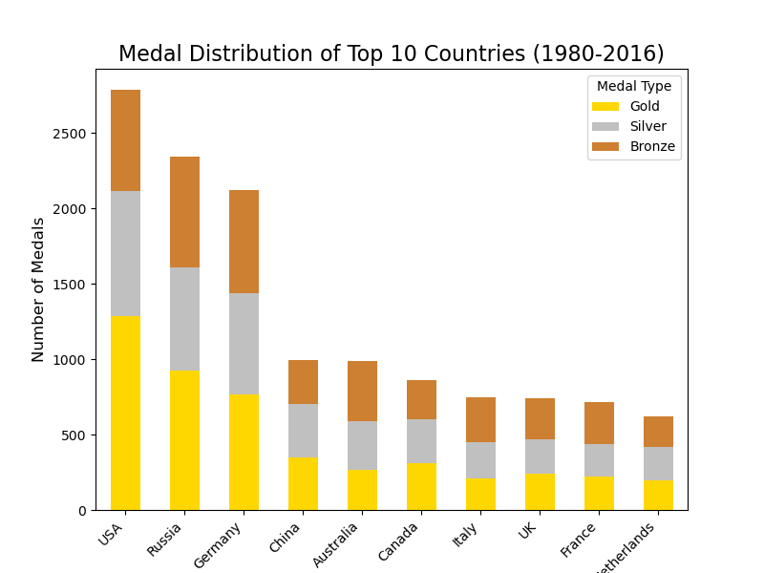
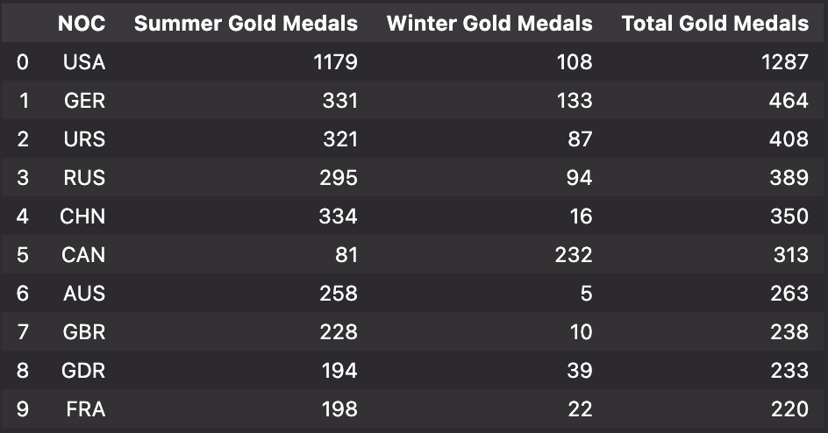
Top 10 Medal Distribution
USA leads the medal count with over 2,500 total medals, dominating the gold medal category as well.
Russia and Germany are powerhouses in both Summer and Winter Games, with a more balanced distribution of medals across the two seasons. Germany, in particular, has a strong Winter Olympics tradition.
China's medal count is predominantly from the Summer Olympics, where it excels in specific sports, leading to a high gold medal count.
Canada and Germany stand out for their Winter Olympics performance, contributing significantly to their total medal counts.
This analysis highlights that while the top 10 countries are consistent leaders in overall medal counts, their strengths can vary significantly between the Summer and Winter Olympics. The USA's dominance is primarily in the Summer Games, while countries like Germany and Russia maintain strong performances across both seasons. This suggests that each country's sports programs may be tailored to excel in specific seasonal events, reflecting their historical and cultural ties to certain sports.

Slide 25
Conclusion
Conclusion
Our analysis of the Olympic Games from 1980 to 2016 reveals several key trends:
Participation Growth: Athlete participation has surged, especially among women—Summer Olympics female participation increased by 254%, and Winter by 370%.
Physical and Age Characteristics: Athletes in both seasons have similar physical attributes, with slight age differences in peak performance—24-25 years for Summer and 22-23 years for Winter.
Geographic Insights: The USA, Canada, and Italy show strong participation across both seasons, with Canada excelling in Winter sports. Hosting the Games boosts medal counts, as seen with Canada.
Popular Sports: Athletics and Swimming dominate Summer, while Alpine Skiing and Biathlon lead Winter. Participation in these sports continues to grow.
Medal Dominance: The USA excels in Summer Games, while Germany, Russia, and Canada perform strongly in Winter.
In summary, the Olympics reflect growing inclusivity and strategic advantages in hosting, with countries leveraging their strengths in specific sports across seasons.

Slide 26
Thank You

